Slide 1
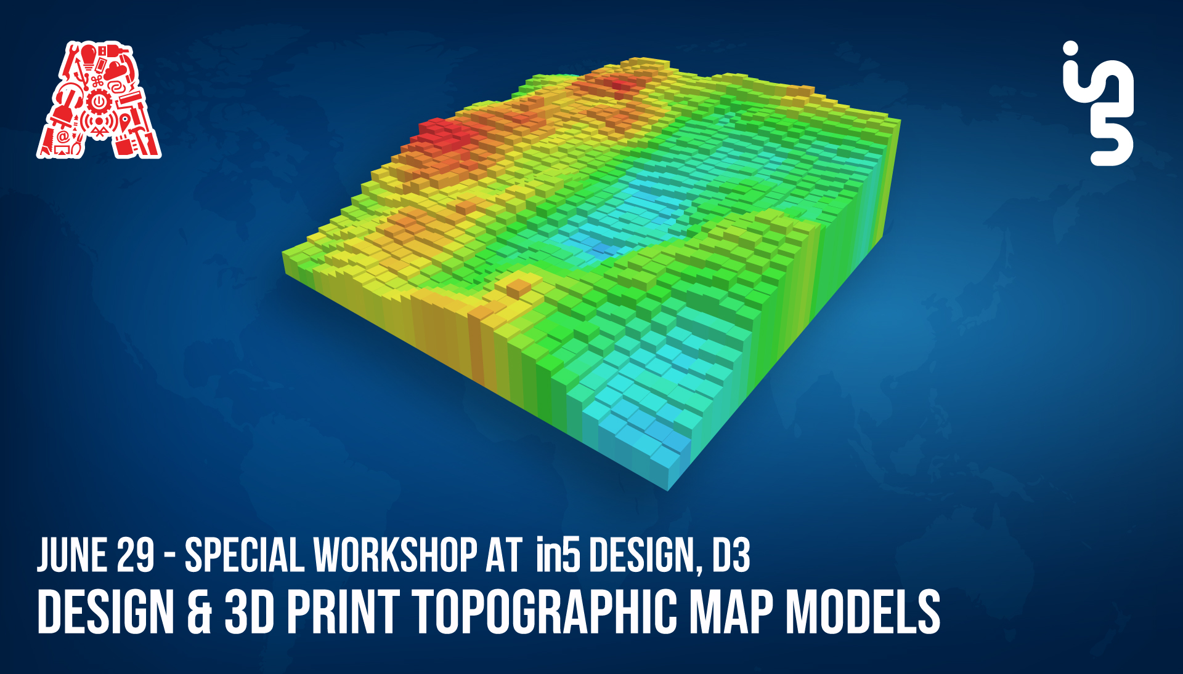

Slide 2
About the Assembly
A smart lab based out of In5 since Dec 2014
Over 250 free workshops done
ASSEMBLY: HACK - Embedded systems, iOT and hardware
ASSEMBLY: CODE - Software projects - APIs, frameworks, apps
Age range: 16-60 - students, professionals, entrepreneurs
Focus on smart technology and practical applications
Forum: members.theassembly.ae

Slide 3
TAG US ON OUR SOCIAL MEDIA
FACEBOOK
TWITTER
INSTAGRAM
YOUTUBE
The Assembly (@MakeSmartThings)
@MakeSmartThings
@MakeSmartThings
The Assembly

Slide 4
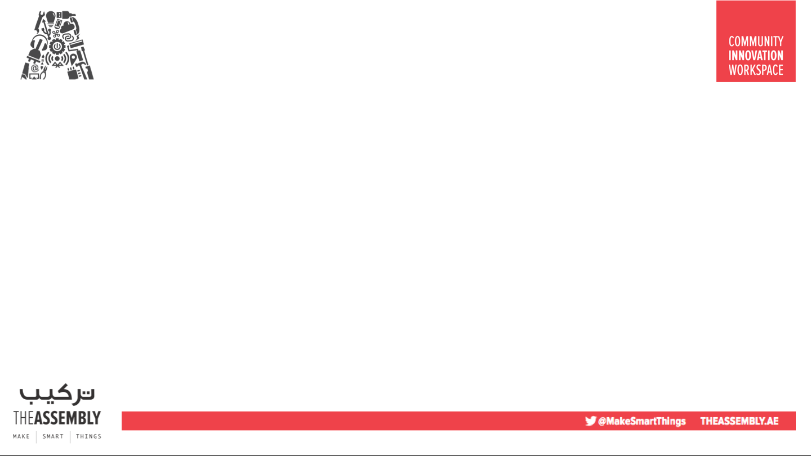

Overview
TOPICS:
3D printing
Previous 3D printing workshops
Topographic Maps
2D image to 3D model conversion
3D model printing
Task I – Designing and building a 3D topographic model
Task II – Printing a 3D model
Task III – Adding a label to a 3D model

Slide 5
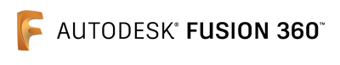



Dependencies
Terrain Map http://terrain.party/
Design Software:
Blender https://www.blender.org/download/
Autodesk Fusion 360 https://www.autodesk.com/products/fusion-360/overview#banner
Slicing Software:
Cura https://ultimaker.com/en/products/ultimaker-cura-software

Slide 6
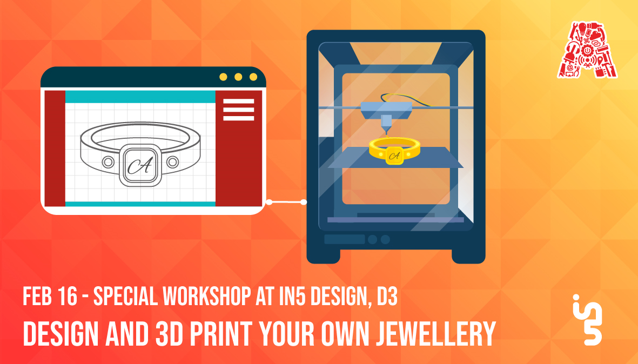
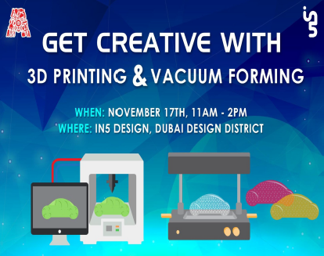
Previous 3D printing Workshops

Slide 7
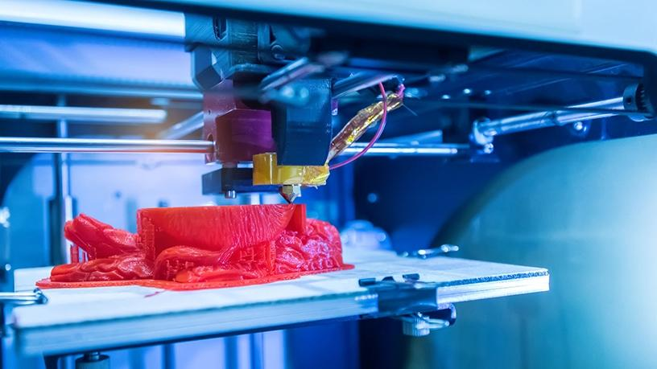
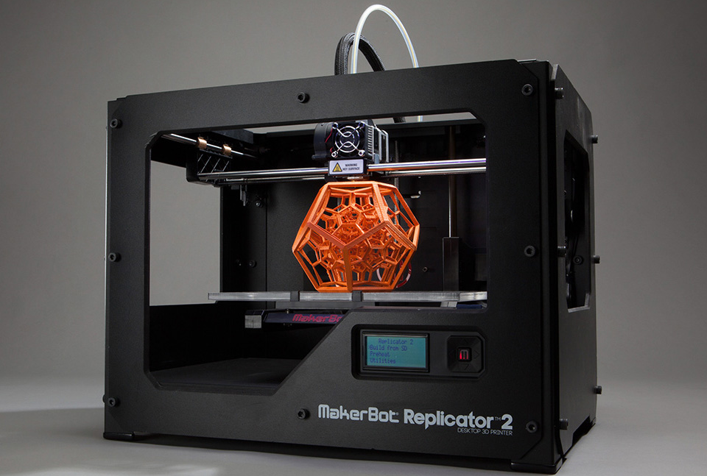
What is 3D printing?
Process of taking a 3D digital model and making it a physical object, by forming successive layers of material under computer control.
Notes:
It is not just a 3D scene graph or a mark-up language; the core is a powerful entity-component framework that provides a declarative, extensible, and composable structure to three.js(cross-browser JavaScript library and Application Programming Interface (API) used to create and display animated 3D computer graphics in a web browser) .

Slide 8
What can you do with it?
Industrial Production
Build Proof Of Concept (POC)
Rapid Prototyping
Marketing Samples
Education
Art
Fashion
Hobbyists

Slide 9
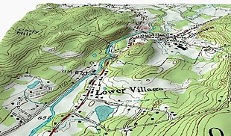
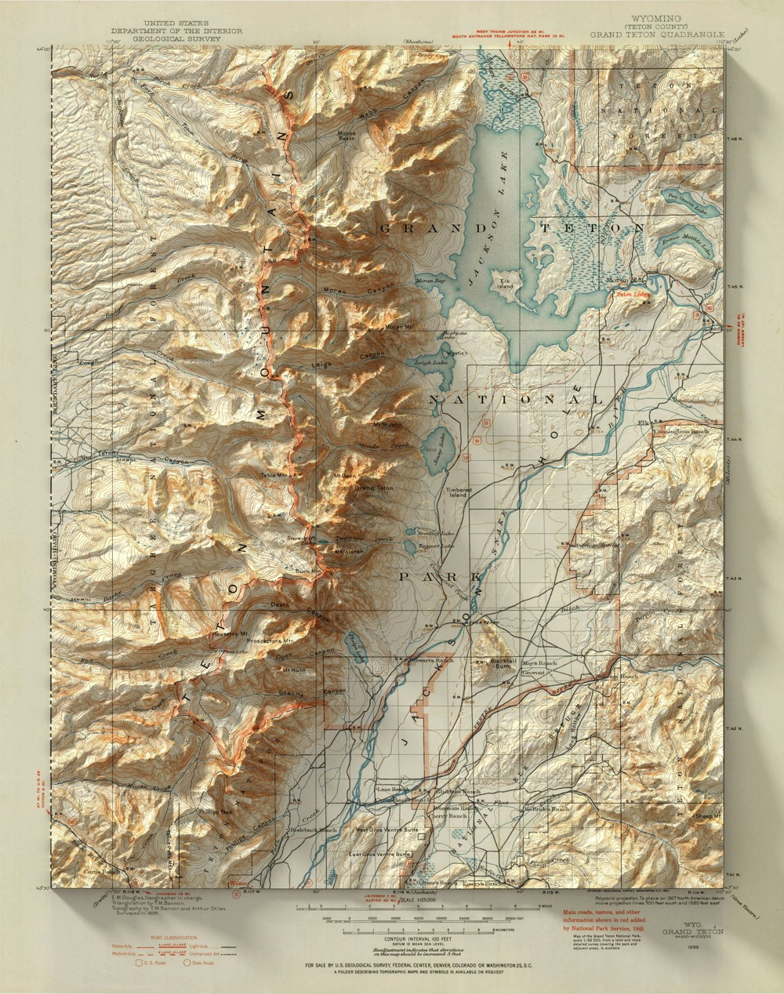
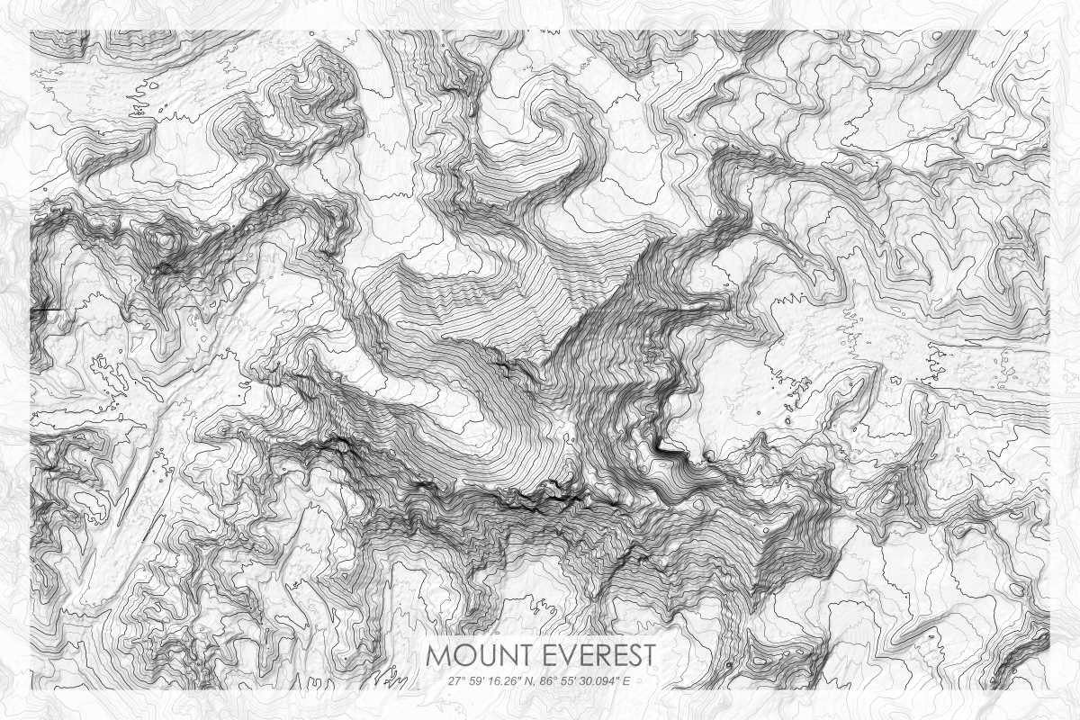
What is topographic mapping?
A topographic map is a type of map characterized by large-scale detail and quantitative representation of relief, usually using contour lines. Traditional definitions require a topographic map to show both natural and man-made features. A contour line is a line connecting places of equal elevation.
Notes:
The goal being augmented reality features directly on web browsers without sacrificing performance.
It is a pure web solution, so no installation required.
It is completely open source and free of charge
works on any phone with webgl and webrtc.

Slide 10
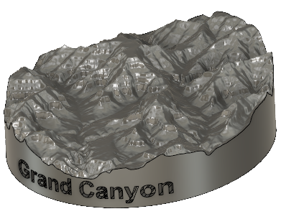
What is topographic mapping?
A plastic model of terrain for school education
A small-scale version of a national park
A model that shows the overview of a real-world race track
A tiny version of a mountain you climbed in the past.
Thanks to these models, we can see the landscape from a bird’s eye view. Input data will be topographic maps that are most interesting for 3D printing purposes.

Slide 11
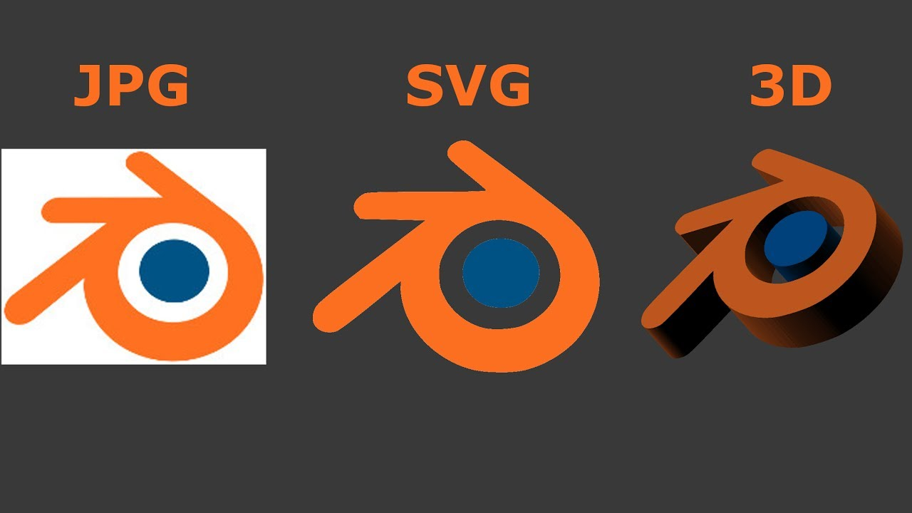
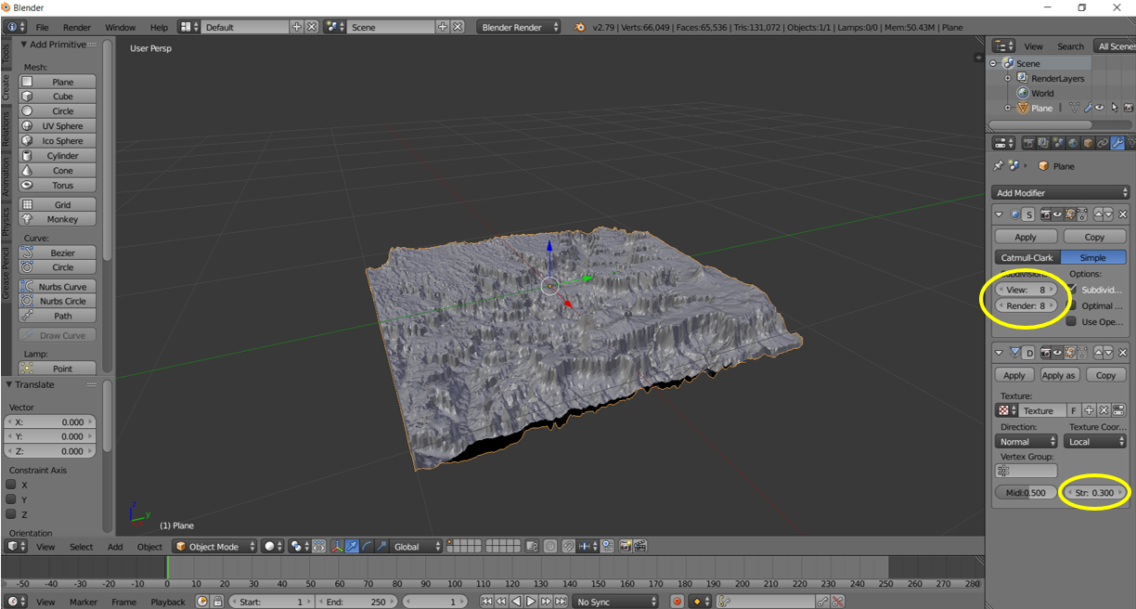
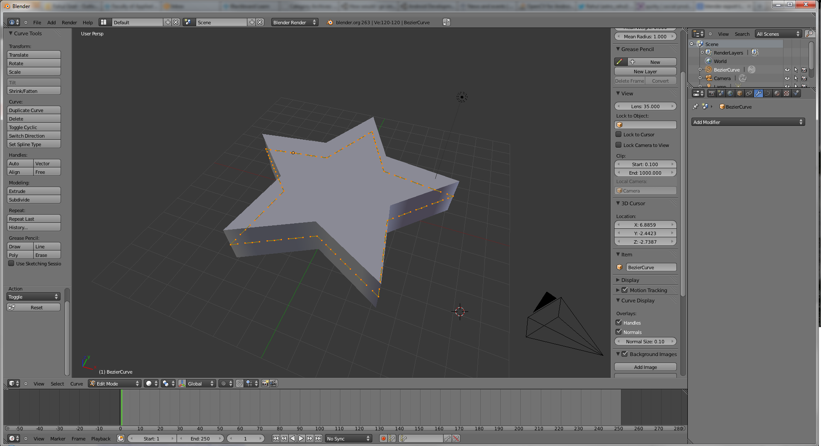
Converting a 2D image into a 3D model
Blender is the free and open source 3D creation suite. It supports the entirety of the 3D pipeline—modeling, rigging, animation, simulation, rendering, compositing and motion tracking, even video editing and game creation.
Notes:
The goal being augmented reality features directly on web browsers without sacrificing performance.
It is a pure web solution, so no installation required.
It is completely open source and free of charge
works on any phone with webgl and webrtc.

Slide 12
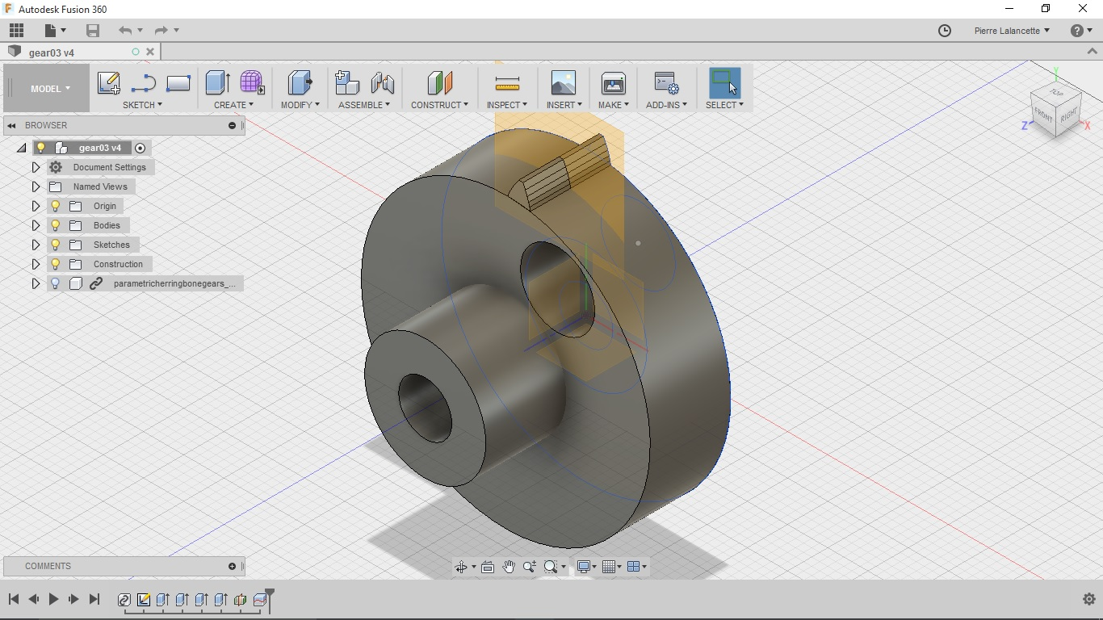
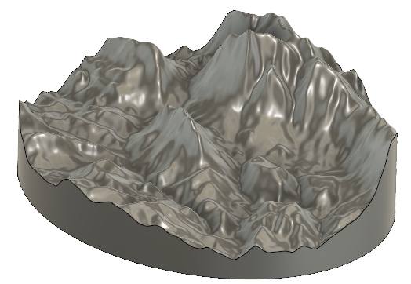
Converting a 2D image into a 3D model
Fusion 360 is the first 3D CAD, CAM, and CAE tool of its kind that connects your entire product development process in a single cloud-based platform that works on PC, Mac, and mobile devices.

Slide 13
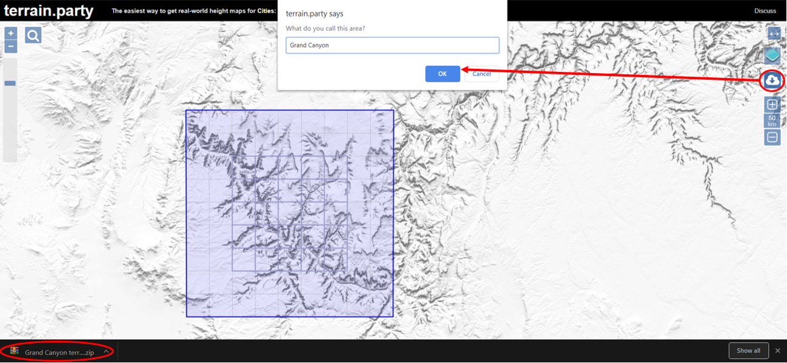
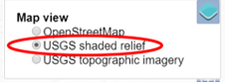
Task I – Designing and building a 3D topographic model

Slide 14
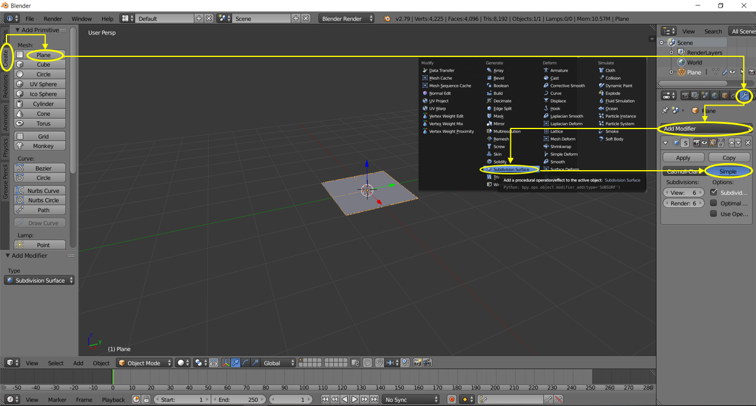
Increase Render and View to max value for higher number of subdivisions on plane

Slide 15
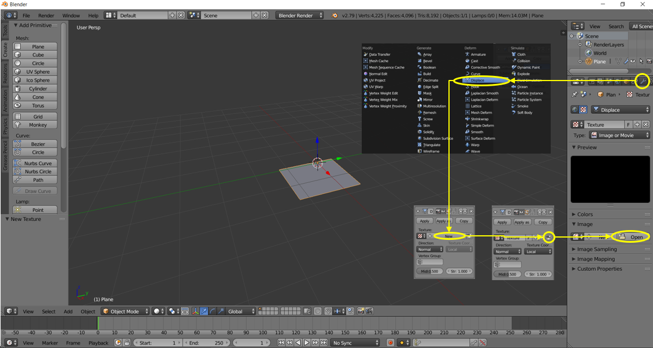
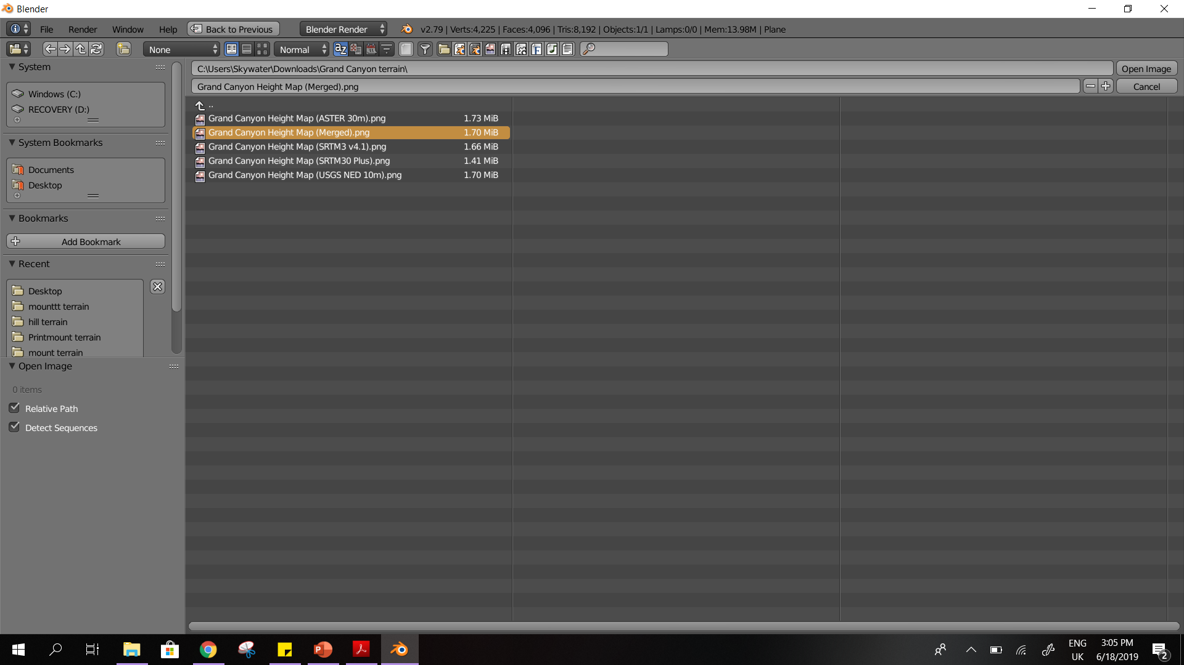

Slide 16
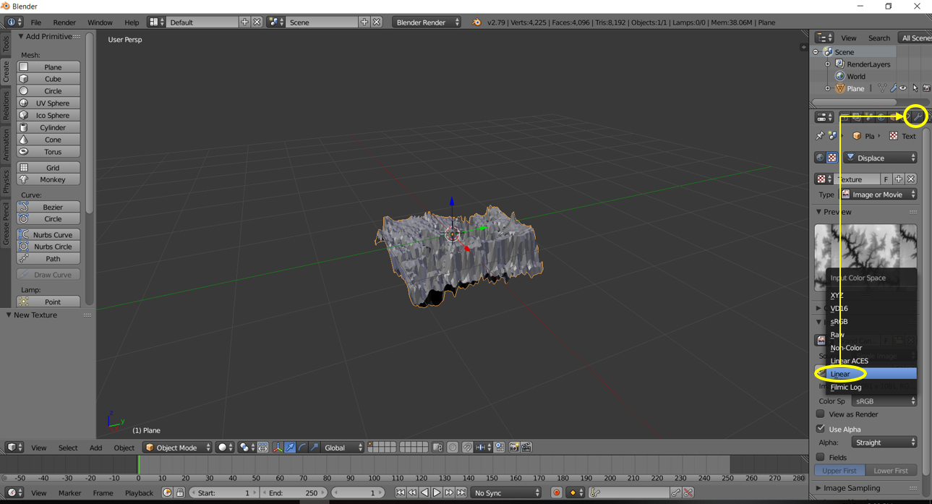

Slide 17
Vary subdivisions to change the level of detail of terrain
Vary strength to manipulate elevation

Slide 18
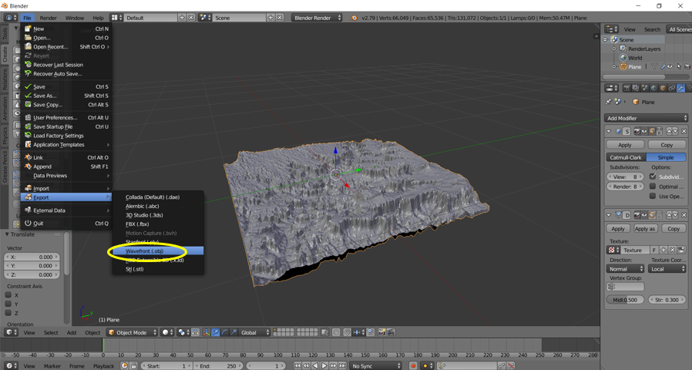
Save terrain as .obj file

Slide 19
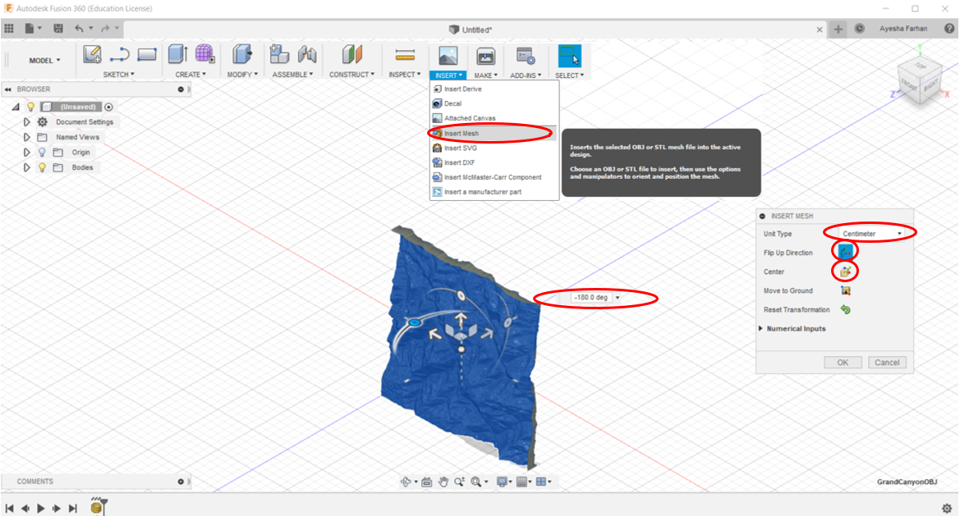
Flip the model
-180˚ to have it facing upwards

Slide 20
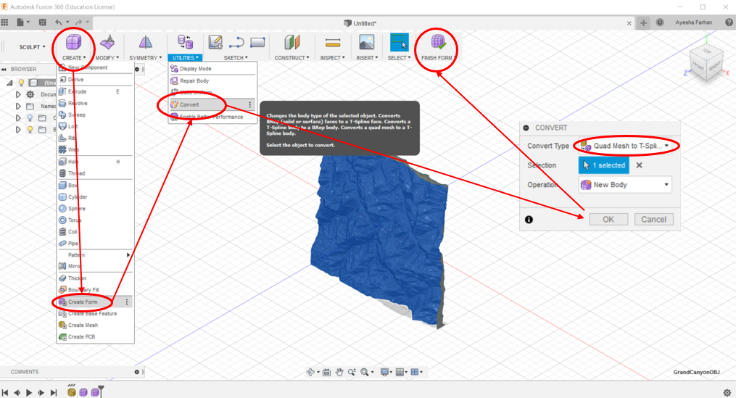

Slide 21
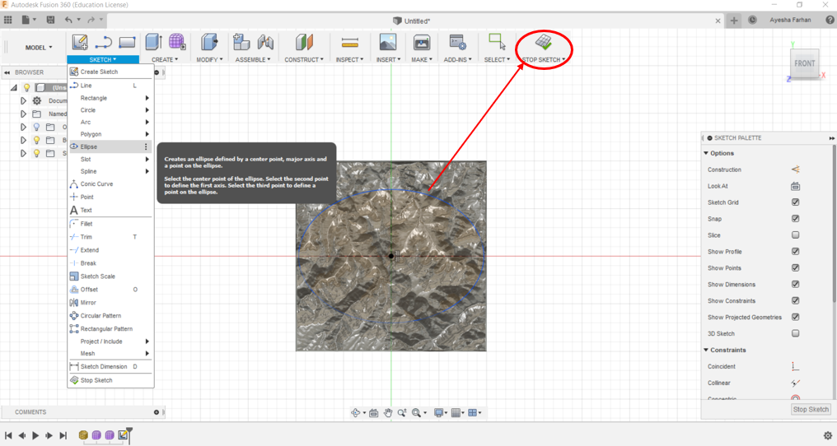

Slide 22
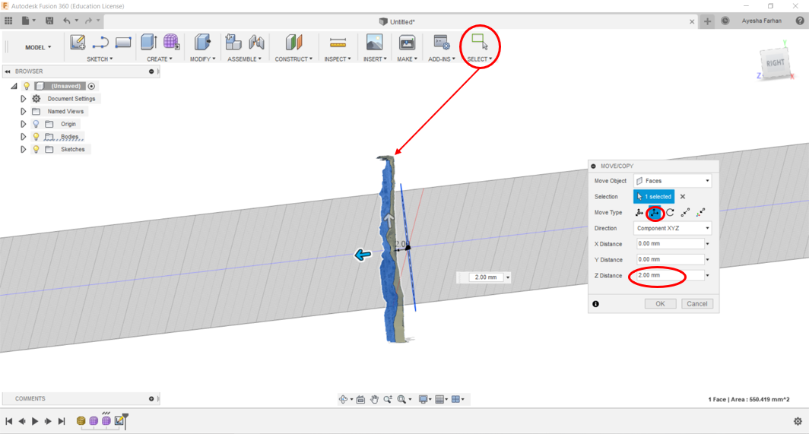
Select the terrain model and move it just above the shape

Slide 23
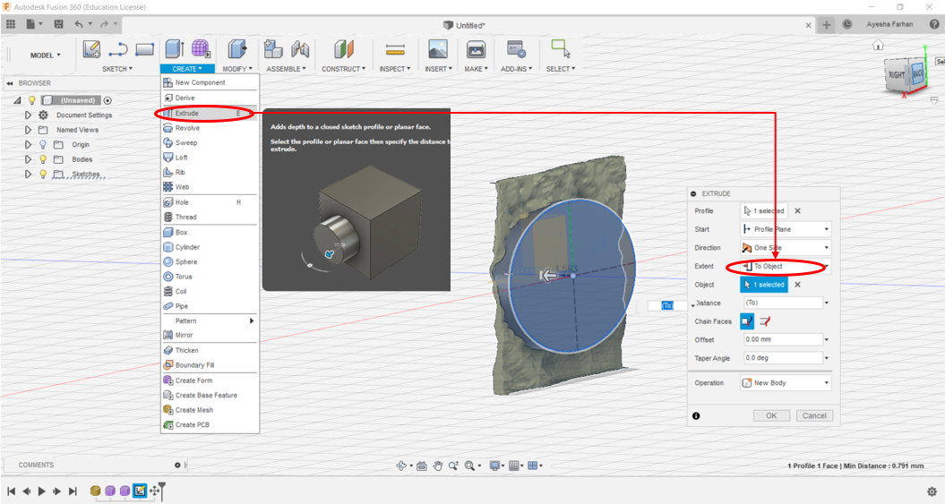
Select the shape and extrude it into the terrain model

Slide 24
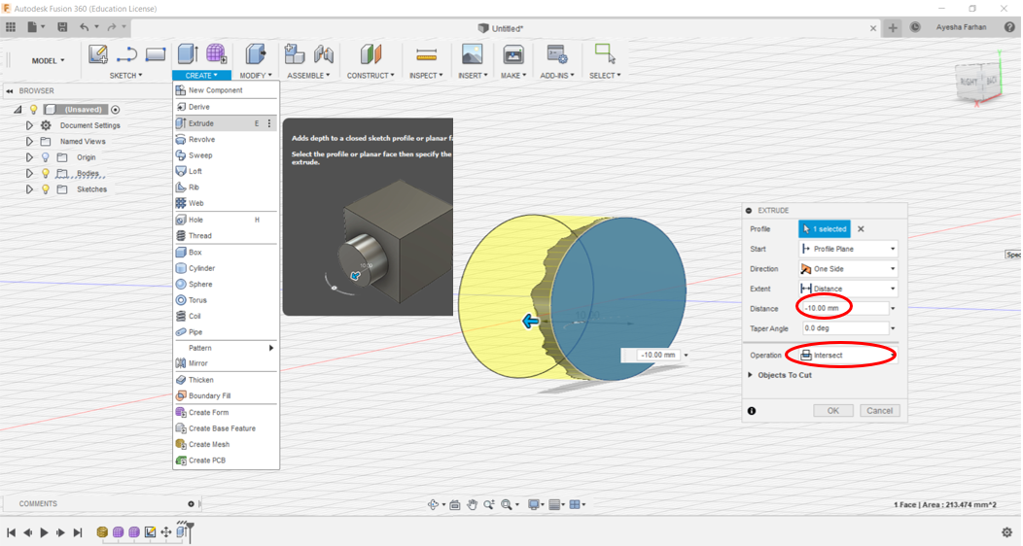
Select the base of the model and extrude to intersect

Slide 25
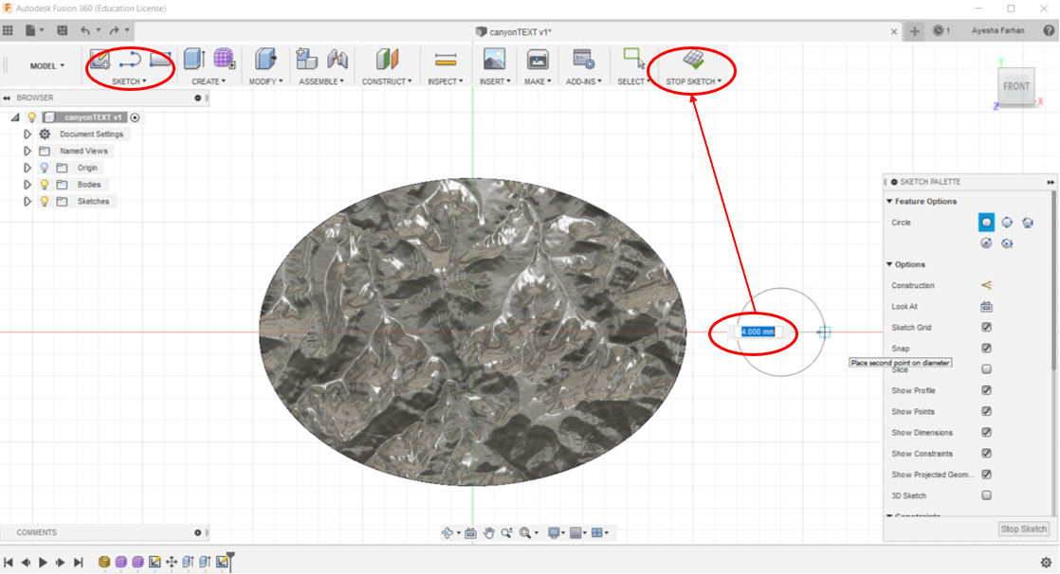

Slide 26
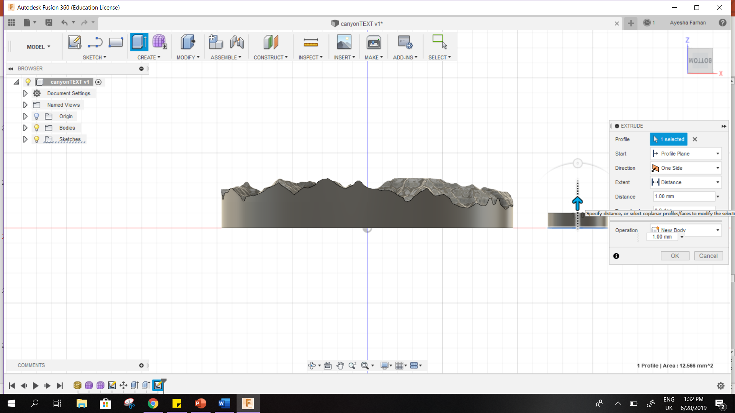
Right click the shape and extrude

Slide 27
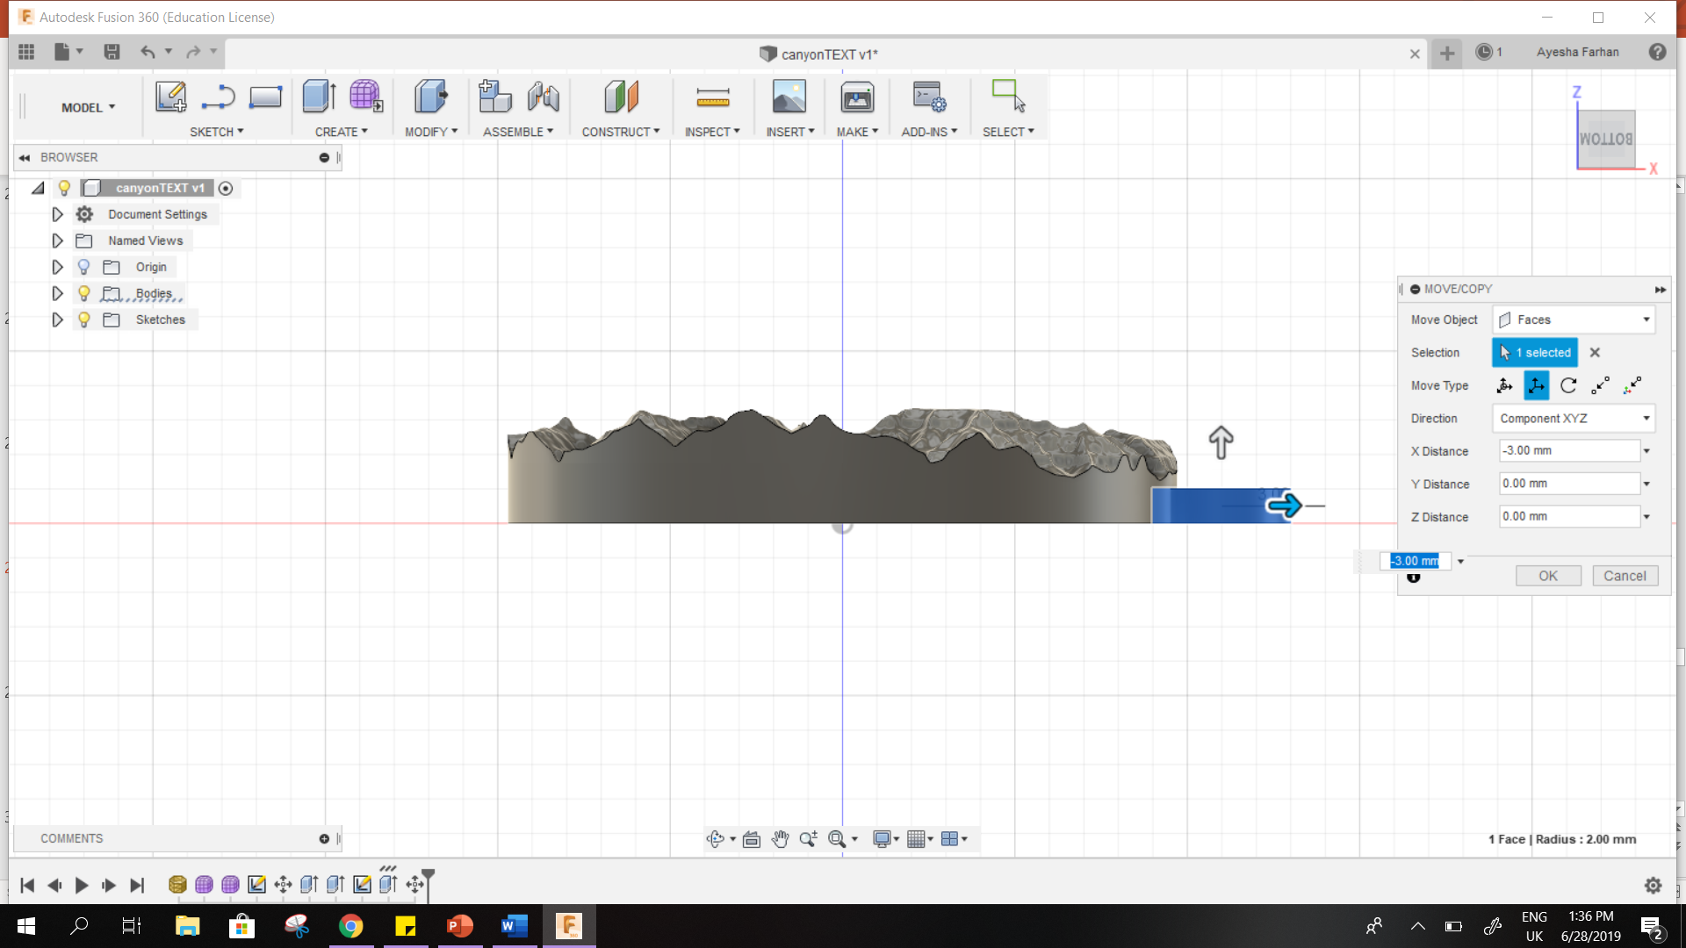
Right click the shape and move to overlap shape with the model

Slide 28
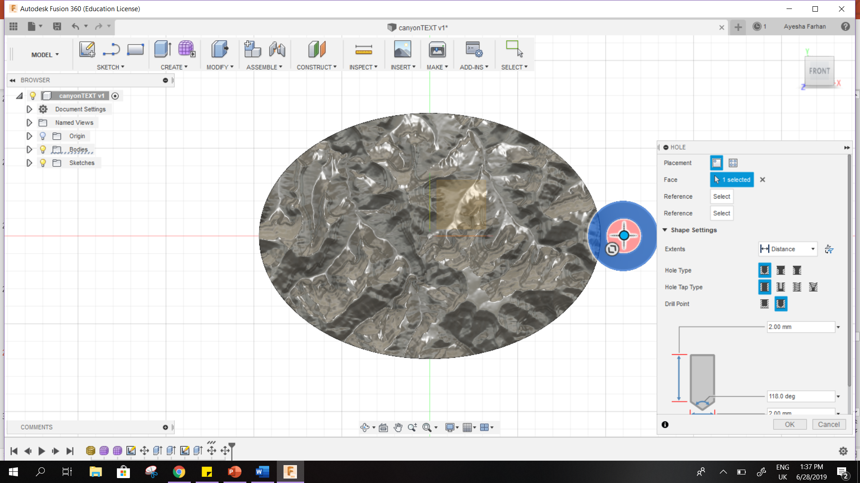
Right click the shape and place hole to make a loop

Slide 29
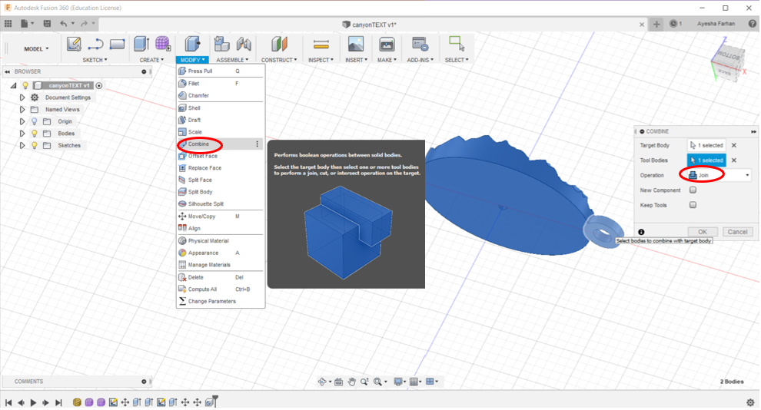
Combine the two bodies to form one model

Slide 30
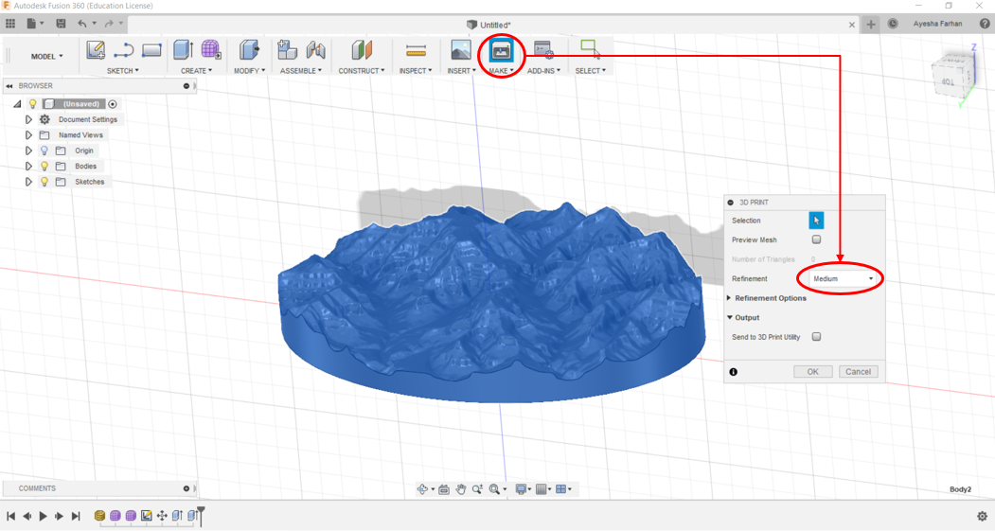
Select the entire model and save as .stl file for printing

Slide 31
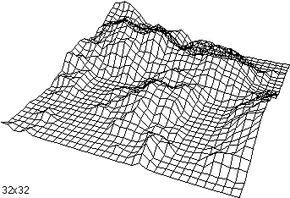
Printing a 3D model
STL (Standard Triangle Language):
Stores model as a mesh of triangles
Output of design software
A slicer software is required for slicing which is the process of :
Cutting a 3D model into individual layers
Generating G-code for the 3D printer from an STL file
G-code (Geometric Code):
Set of commands passed to a 3D printer on how to print a model
Generated ‘automagically’ by a slicing software like Cura/Simplify3D

Slide 32
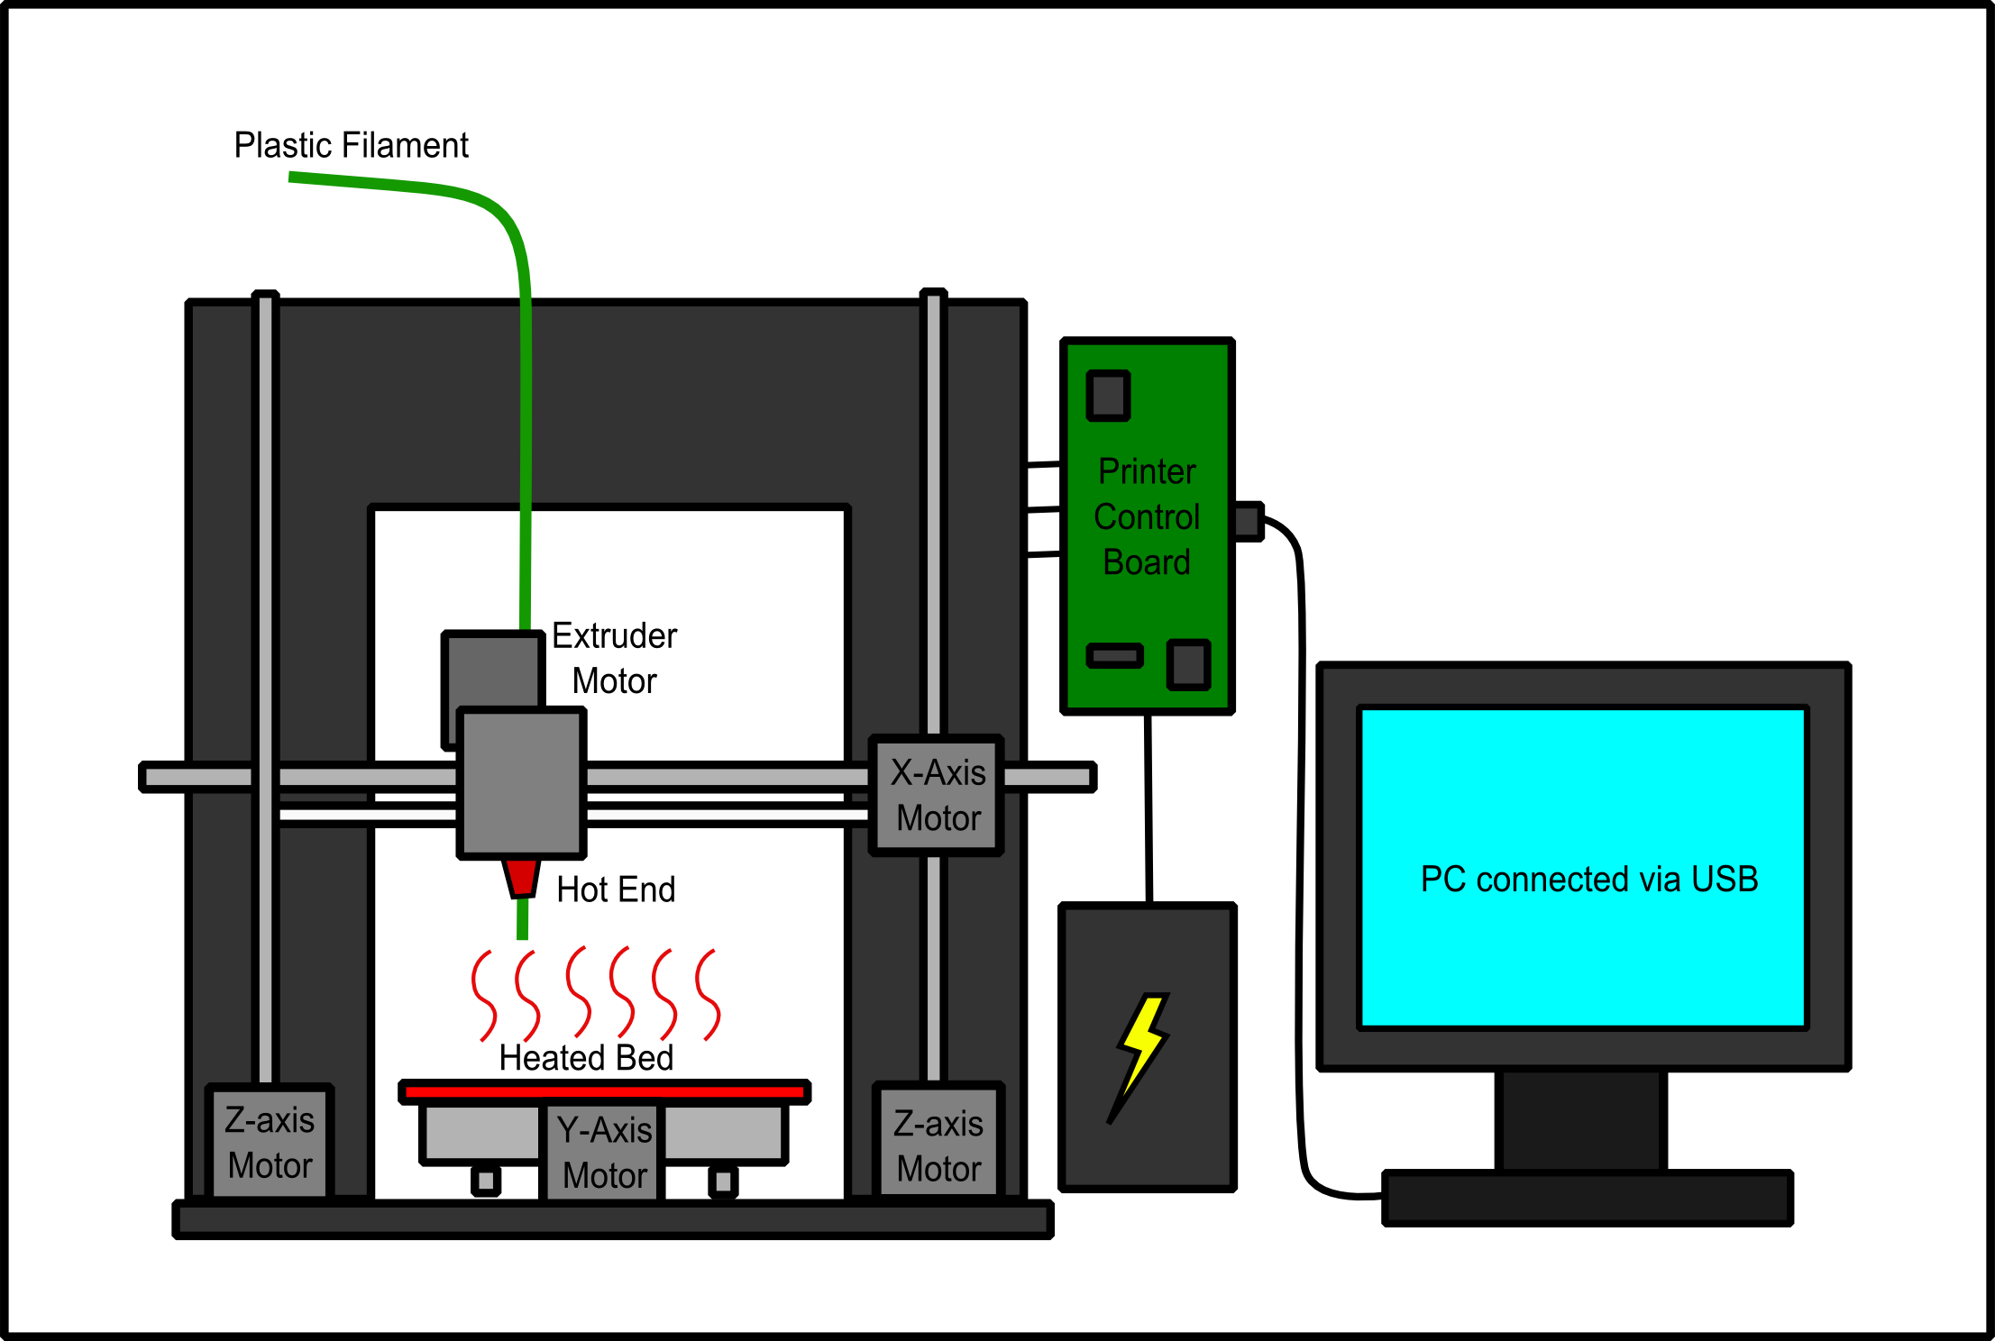
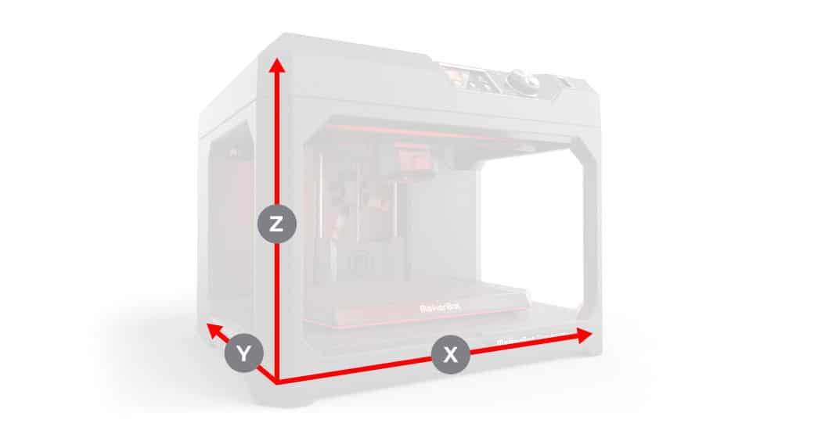
Anatomy of a 3D Printer
Filament: PLA
biodegradable
odorless
lower temperature
less warp
Notes:
Analogy
making a loaf of sliced bread, but in inverse
baking each individual slice of bread and then gluing them together into a whole loaf
thousands of tiny little slices, then makes it from the bottom-up, slice by slice
tiny layers stick together to form a solid object
Type of printing technique used Fused Deposition Modeling (FDM) ,
Tiny piece of filament/material (1.75mm/3mm) used to print these models (one color)
Th extruder sucks the filament heats it and places it on the base (heated /non- heated bed), as it starts layering it the filament is also cooled at the same time therefore solidifying and providing a solid base for the next layer
The x motor moves left and right, y motor moves the plate up and down, z motor moves the extruder away or towards the plate, adding depth
All this is done by send g-code commands from the slicer software, which converts your model into a code like format which makes it easier for your printer to understand what points it has to move and extrude.

Slide 33
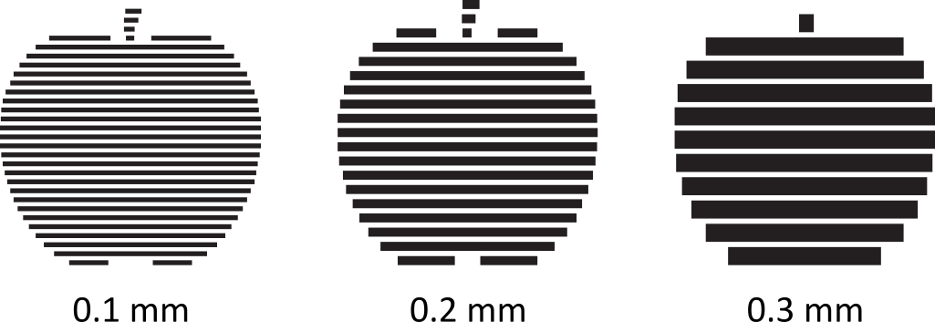
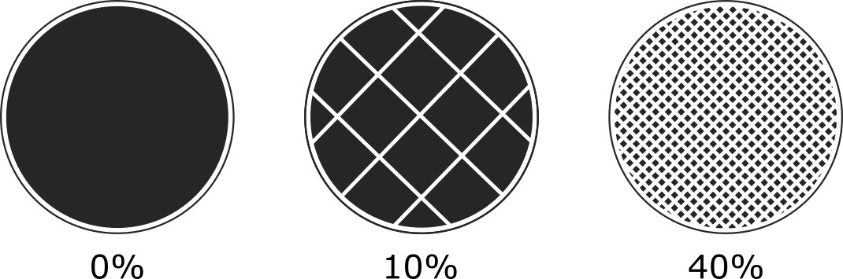
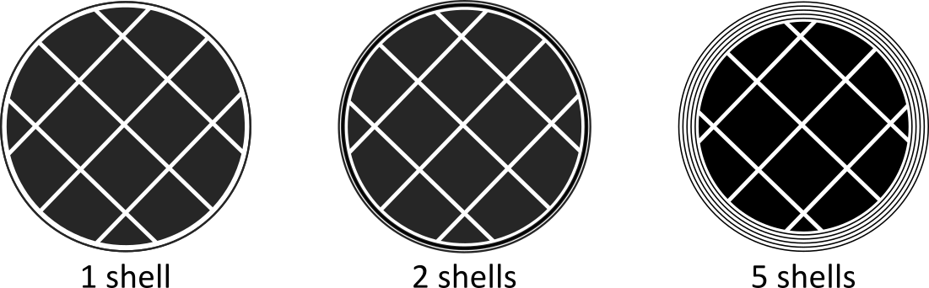

Important Terminology
Resolution | Infill | Shells
Thickness of each layer | Internal structure/density | Outlines on each layer
Overhang
When a layer extends outward and hangs unsupported over another layer

Slide 34
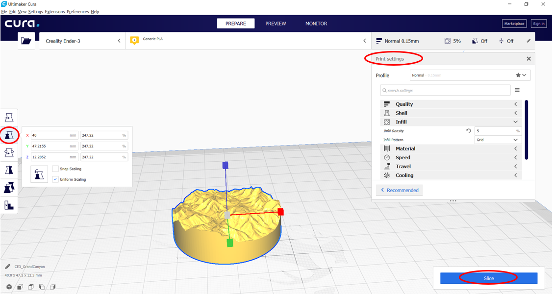
Task II – Printing a 3D model

Slide 35
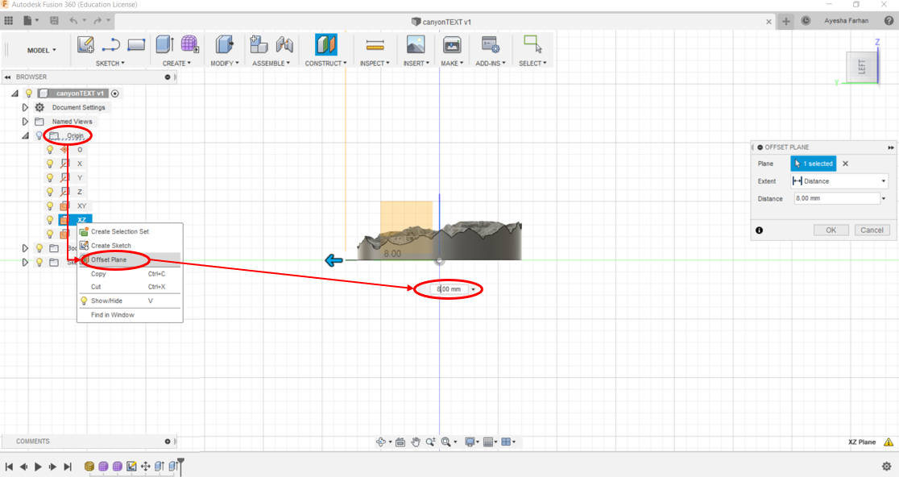
Task III – Adding a label to a 3D model

Slide 36
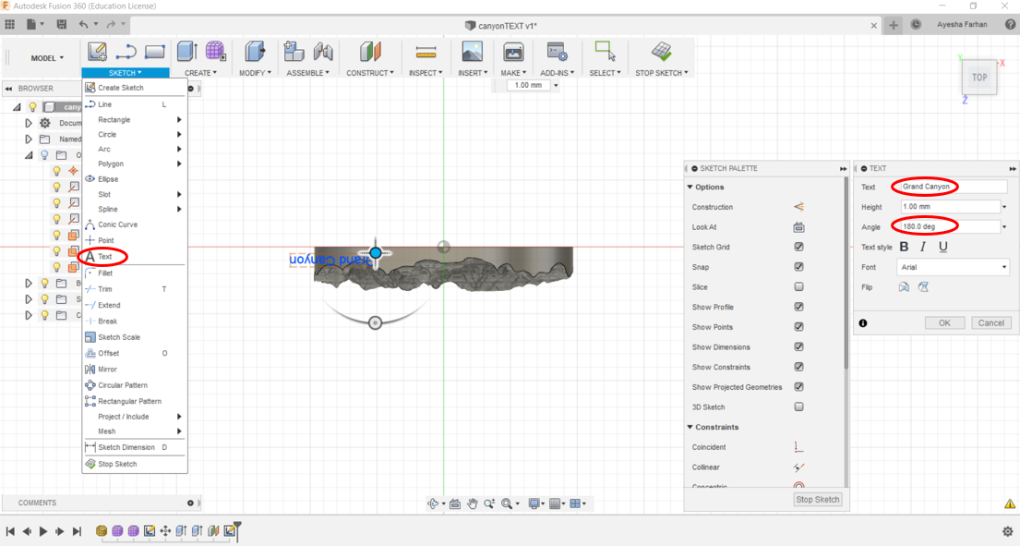
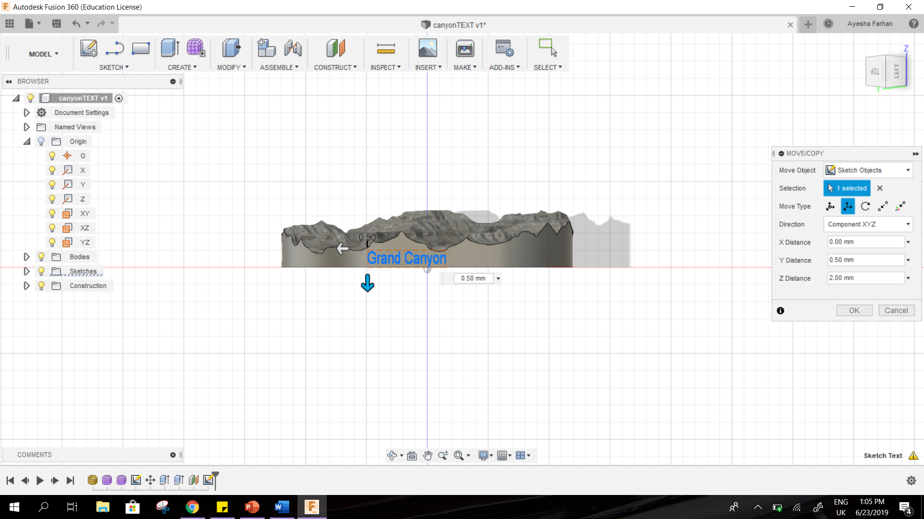
Move the text around the model

Slide 37
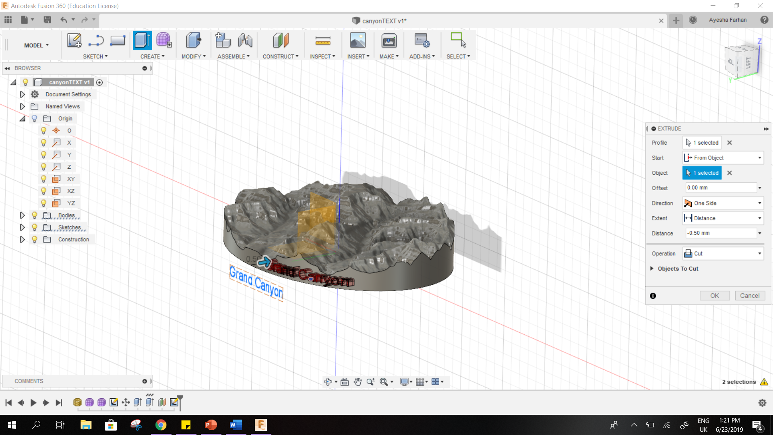

Slide 38
THANK YOU!
Adapted from: Joe Brewer’s “How To 3D Print A Mountain”
https://www.youtube.com/watch?v=bSNy9iUqDbI

